Slide 1





Day 3 CRUD Operations
Sean Wong
2025/08/04

Slide 2
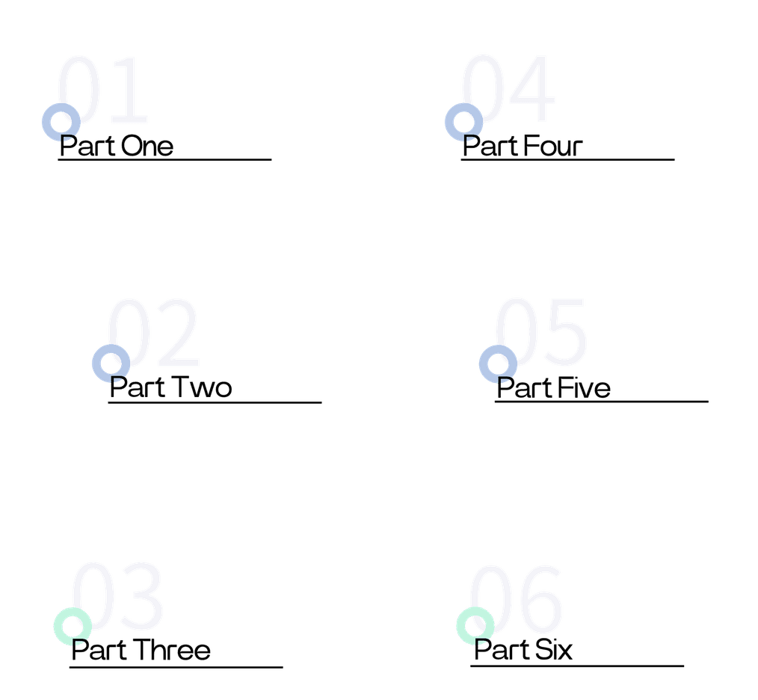

CONTENTS
Kick-off & Targets
CRUD Foundations
Read & Filter
Update & Delete
Aggregation
Practice & Recap

Slide 3

Kick-off & Targets

Slide 4

Welcome to CRUD Day 3
Session Overview
Hands-On Learning
Today, we will dive deep into CRUD operations—Create, Read, Update, and Delete. These operations are the backbone of any relational database, enabling you to manage data efficiently in MySQL.
This session is highly interactive. You will practice inserting, retrieving, updating, and deleting data in the employees table. By the end, you will have a solid grasp of these essential SQL commands.

Slide 5




Perform Insert Operations
Learn to add new records to your database using the INSERT INTO statement. Understand how to specify columns and values to ensure accurate data entry.
Retrieve and Filter Data
Today’s Learning Objectives
Master the SELECT statement to fetch data. Use the WHERE clause to filter results based on conditions, and combine it with AND/OR for more complex queries.
Update and Delete Data
Discover how to modify existing records with the UPDATE statement and safely remove data using DELETE. Emphasize the importance of using WHERE to target specific rows.

Slide 6
CRUD Foundations

Slide 7



Create
Read
Create refers to adding new data to the database using the INSERT INTO statement. This operation is crucial for populating tables with initial data.
Read involves retrieving data from the database using the SELECT statement. This operation allows you to fetch specific columns or entire rows based on your query.
Update
Delete
What CRUD Means in MySQL
Update modifies existing data in the database using the UPDATE statement. It is essential for keeping your data current and accurate.
Delete removes data from the database using the DELETE statement. Use this operation with caution, as it permanently deletes records.

Slide 8

Create Rows with INSERT INTO
INSERT INTO Syntax
The INSERT INTO statement adds new rows to a table. Specify the table name, column names, and values. For example, INSERT INTO employees (name, department, salary) VALUES ('John Doe', 'HR', 50000);

Slide 9





Bulk Insert Multiple Rows
Bulk Insert Syntax
Use Case
To insert multiple rows at once, list multiple sets of values. For example: INSERT INTO employees (name, department, salary) VALUES ('Jane Smith', 'IT', 70000), ('Mark Johnson', 'Finance', 80000);
Bulk inserts are useful for adding large datasets quickly. They improve performance by reducing the number of database transactions required.

Slide 10
Read & Filter

Slide 11


Selective Columns
Read Data Using SELECT
For better performance and clarity, specify only the columns you need. For example: SELECT name, salary FROM employees;
Basic SELECT Syntax
Use the SELECT statement to retrieve data from a table. Specify the columns you need or use * to select all columns. For example: SELECT * FROM employees;
Efficiency
Selecting specific columns reduces the amount of data transferred, improving query performance and network efficiency.

Slide 12

Filter with WHERE Clause
WHERE Clause
The WHERE clause filters records based on a condition. For example: SELECT name, department FROM employees WHERE salary > 60000;
Logical Operators
Combine conditions using AND and OR. For example: SELECT * FROM employees WHERE department = 'IT' AND salary > 70000;

Slide 13

Sort Results Using ORDER BY
ORDER BY Syntax
Use ORDER BY to sort results. Specify the column and direction (ASC or DESC). For example: SELECT name, salary FROM employees ORDER BY salary DESC;

Slide 14


Limit Rows with LIMIT
LIMIT Clause
Pagination
Performance
The LIMIT clause restricts the number of rows returned. For example: SELECT * FROM employees LIMIT 5;
Use LIMIT for pagination in web applications. For example, to get the first 10 rows: SELECT * FROM employees LIMIT 10;
LIMIT improves performance by reducing the amount of data processed and transferred.

Slide 15
Update & Delete

Slide 16

Update Rows Securely
Safety
UPDATE Syntax
Use the UPDATE statement to modify existing rows. Specify the table, columns, and new values. For example: UPDATE employees SET salary = 75000 WHERE department = 'IT';
Always use a WHERE clause to target specific rows. Omitting WHERE will update all rows, which can lead to unintended changes.

Slide 17





Irreversibility
Deleted data cannot be recovered. Always ensure your WHERE clause is correct to avoid accidental data loss.
Backup
DELETE Syntax
Consider backing up data before performing DELETE operations, especially in production environments.
The DELETE statement removes rows from a table. For example: DELETE FROM employees WHERE name = 'Mark Johnson';
Delete Rows Safely

Slide 18
Aggregation

Slide 19
COUNT Function
SUM Function
AVG Function
COUNT returns the number of rows in a result set. For example: SELECT COUNT(*) FROM employees;
SUM calculates the total sum of a numeric column. For example: SELECT SUM(salary) FROM employees;
AVG computes the average of a numeric column. For example: SELECT AVG(salary) FROM employees;
Count Sum Average Functions

Slide 20



GROUP BY Clause
Use GROUP BY to group rows by a column. For example: SELECT department, COUNT(*) FROM employees GROUP BY department;
Aggregate Functions with GROUP BY
Combine GROUP BY with aggregate functions to summarize data. For example: SELECT department, AVG(salary) FROM employees GROUP BY department;
Group Data with GROUP BY

Slide 21
Practice & Recap

Slide 22
02
03
Task 2: Retrieve Data
Task 3: Update Data
Retrieve employees with salaries greater than $50,000 using the SELECT statement and WHERE clause.
Update salaries for employees in the IT department using the UPDATE statement.
04
01
Task 4: Delete Data
Task 1: Insert Data
Delete an employee based on a specific condition using the DELETE statement.
Insert new employee records into the employees table using the INSERT INTO statement.
Guided CRUD Lab Tasks

Slide 23






Common CRUD Mistakes List
Common Mistakes
Avoid common CRUD mistakes: forgetting WHERE in UPDATE or DELETE, using SELECT * unnecessarily, omitting ORDER BY for sorting, and not using LIMIT for pagination.

Slide 24

Summary and Next Day Preview
Enhancing Queries
Enhance your queries with WHERE for filtering, ORDER BY for sorting, LIMIT for pagination, and aggregate functions for summarizing data.
Key Takeaways
Next Day Preview
CRUD operations are fundamental for managing data in MySQL. Use SELECT to read, INSERT to create, UPDATE to modify, and DELETE to remove data.
Tomorrow, we will explore JOINs to combine data from multiple tables. This will enable you to retrieve complex data relationships efficiently.

Slide 25



Sean Wong
2025/08/04

